Slide 1
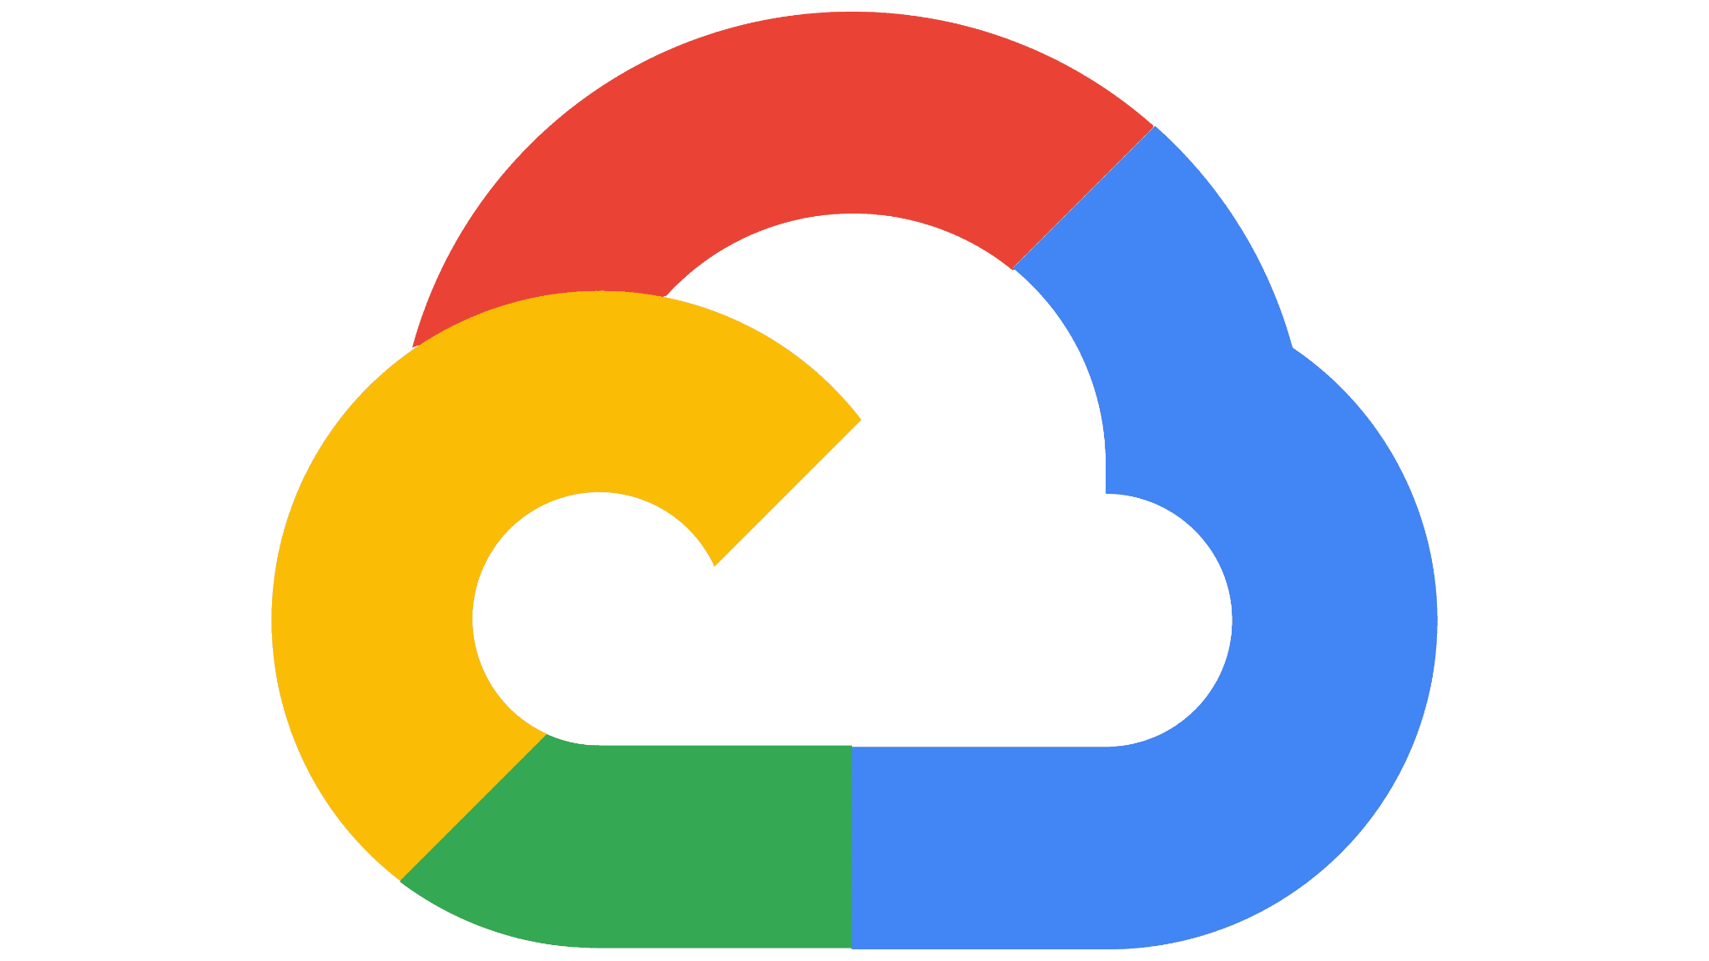


Google Cloud sdsds Product Flashcards
Study Cards for the
Google Cloud Digital Leader Exam
Sarah Walker-Leptich | Walkrinthecloud.com

Slide 2
Build and deploy apps on a fully managed, highly scalable platform without having to manage the underlying infrastructure.​

Slide 3

App Engine
Compute
Platform as a Service

Slide 4
Create and deploy scalable, high-performance VMs.​ There are two versions, standard and flexible.

Slide 5

Compute Engine
Compute
Virtual Machines

Slide 6
Reliably, efficiently, and securely deploy and scale containerized applications on Kubernetes.​

Slide 7

Google Kubernetes Engine (GKE) ​
Compute/Containers
Containers as a Service (CaaS)

Slide 8
Providing hardware to run specialized workloads with low latency on Google Cloud.​

Slide 9
Bare Metal Solution ​
Compute

Slide 10
Add GPUs (graphics processing unit) to your workloads for machine learning, scientific computing, and 3D visualization.​

Slide 11

Cloud GPUs ​
Compute

Slide 12
Help meet compliance, licensing, and management needs by keeping your instances physically separated with dedicated hardware.​

Slide 13
Sole-tenant nodes ​
Compute
Dedicated Virtual Machines​

Slide 14
Migrate and run your VMware workloads natively on Google Cloud.​​

Slide 15
Google Cloud VMware Engine​
Compute

Slide 16
Migrate servers and VMs from on-premises or another cloud to Compute Engine.

Slide 17
Migrate for Compute Engine​ ​
Compute
Dedicated Virtual Machines​

Slide 18
Deploy affordable, short-lived compute instances suitable for batch jobs and fault-tolerant workloads.​

Slide 19
Preemptible VMs​​ ​
Compute
​

Slide 20
Deploy hardened virtual machines on Google Cloud.​

Slide 21
Shielded VMs​ ​
Compute
​

Slide 22
Run your code with zero server management with this scalable, pay-as-you-go functions-as-a-service (FaaS) offering.

Slide 23

Cloud Functions ​
Compute
Functions as a Service

Slide 24
Store, manage, and secure your container images. Deploy only trusted containers on GKE.

Slide 25

Container Registry​
Containers
Developer Tools

Slide 26
Considered as the next generation of container registry. A fully-managed service with support for both container images and non-container artifacts.

Slide 27
Artifact Registry​
Containers
Developer Tools

Slide 28
Continuously build, test, and deploy containers using the Google Cloud infrastructure.​

Slide 29

Cloud Build
Containers
CI/CD

Slide 30
Take advantage of containers preconfigured with data science frameworks, libraries, and tools. Efficiently run batch jobs using Kubernetes.​

Slide 31
Deep Learning Containers
Containers
AI Container Management

Slide 32
Deploy pre built containerized apps.

Slide 33
Kubernetes applications on Google Cloud Marketplace​
Containers
Pre built containers

Slide 34
Serverless, highly scalable, and cost-effective multi-cloud data warehouse designed for business agility. Built-in ML.

Slide 35

BigQuery
Database/Data Analytics
Serverless Data Warehouse

Slide 36
Run large analytical and operational workloads using this fully managed, scalable NoSQL database service.

Slide 37

Cloud Bigtable
Database
NoSQL: Key-value

Slide 38
A highly scalable NoSQL database for your web and mobile applications.

Slide 39

Datastore
Database
NoSQL: Indexed

Slide 40
Manage relational data for MySQL, PostgreSQL, and SQL Server for workloads under 30TB.

Slide 41

CloudSQL
Database
RDBM

Slide 42
Easily develop rich applications using a fully managed, scalable, and serverless document database for both web and mobile apps. Key feature: Able to store and sync data in realtime.

Slide 43

Firestore
Database
NoSQL Document Data Storage

Slide 44
Reduce latency with scalable, secure, and highly available in-memory service.
Notes:
An in-memory database is a database management system that primarily relies on main memory for computer data storage.

Slide 45

Memorystore
Database
In-memory Data Store

Slide 46
Fully managed relational database with massive scale, strong consistency worldwide, and up to 99.999% availability.
Notes:
An in-memory database is a database management system that primarily relies on main memory for computer data storage.

Slide 47

Cloud Spanner
Database
RDCMs for Global Reach.

Slide 48
Deploy open-source data and analytics (batch) processing services (Apache Hadoop, Apache Spark, etc.) with improved efficiency and security.
Notes:
An in-memory database is a database management system that primarily relies on main memory for computer data storage.

Slide 49

Dataproc
Data Analytics
Open Source Processing

Slide 50
Unify stream and batch data processing that's serverless, fast (real-time), and cost-effective.
Notes:
An in-memory database is a database management system that primarily relies on main memory for computer data storage.

Slide 51

Dataflow
Data Analytics
Serverless Data Processing

Slide 52
Business intelligence software and big data analytics platform that helps you explore, analyze and share real-time business analytics easily.
Notes:
An in-memory database is a database management system that primarily relies on main memory for computer data storage.

Slide 53

Looker
Data Analytics
Business Intelligence

Slide 54
Quickly build and manage data pipelines using fully managed, code-free data integration with a graphical interface​.
Notes:
An in-memory database is a database management system that primarily relies on main memory for computer data storage.

Slide 55

Cloud Data Fusion
Data Analytics
Data Integration

Slide 56
Discover and understand your data using a fully managed and scalable data discovery and metadata management service.​
Notes:
An in-memory database is a database management system that primarily relies on main memory for computer data storage.

Slide 57

Cloud Catalog
Data Analytics
Data Discovery & Metadata Management

Slide 58
Create, schedule, monitor, and manage workflows using a fully managed orchestration service built on Apache Airflow.​
Notes:
An in-memory database is a database management system that primarily relies on main memory for computer data storage.

Slide 59

Cloud Composer
Data Analytics
Workflow Orchestration

Slide 60
Streaming analytics and data integration pipelines to ingest and distribute data. It is equally effective as a messaging- oriented middleware for service integration or as a queue to parallelize tasks.
Notes:
An in-memory database is a database management system that primarily relies on main memory for computer data storage.

Slide 61

Pub/Sub
Data Analytics
Messaging

Slide 62
Intelligent data service for visually exploring, cleaning, and preparing structured and unstructured data for analysis, reporting, and machine learning.
Notes:
An in-memory database is a database management system that primarily relies on main memory for computer data storage.

Slide 63

Dataprep
Data Analytics
Intelligent Data Preparation

Slide 64
Store any amount of data and retrieve it as often as you'd like, using Google Cloud’s object storage offering. Comes in four different types, Standard, Nearline, Coldline and Archive.
Notes:
An in-memory database is a database management system that primarily relies on main memory for computer data storage.

Slide 65

Cloud Storage
Storage
File Storage

Slide 66
Store data from VM instances running in Compute Engine or GKE, Google Cloud's state-of-the-art block storage offering.
Notes:
An in-memory database is a database management system that primarily relies on main memory for computer data storage.

Slide 67

Persistent Disk
Storage
Block Storage

Slide 68
High-performance, fully managed file storage.
Notes:
An in-memory database is a database management system that primarily relies on main memory for computer data storage.

Slide 69

Filestore
Storage
File Storage

Slide 70
Help protect your services against DoS and web attacks.​
Notes:
An in-memory database is a database management system that primarily relies on main memory for computer data storage.

Slide 71

Cloud Armor
Networking
Web Application Firewall

Slide 72
Cloud Virtual Private Network.Securely extend your on-premises network to Google's network through an IPsec VPN tunnel.
Notes:
An in-memory database is a database management system that primarily relies on main memory for computer data storage.

Slide 73

Cloud VPN
Networking
Virtual Private Network

Slide 74
Virtual Private Cloud (VPC) is a logically isolated section of the Google Cloud​ Network where you can launch Google Cloud resources.​ You choose a range of IPs using the CIDR Range​.
Notes:
An in-memory database is a database management system that primarily relies on main memory for computer data storage.

Slide 75

Cloud VPC
Networking
Virtual Private Cloud

Slide 76
Low latency, high availability connections that enable you to reliably transfer data between your on-premises and Google Cloud Virtual Private Cloud (VPC) networks.​
Notes:
An in-memory database is a database management system that primarily relies on main memory for computer data storage.

Slide 77

Cloud Interconnect
Networking
Virtual Networks

Slide 78
Fully managed service that allows you to easily and securely connect, manage, and ingest data from millions of globally dispersed devices.
Notes:
An in-memory database is a database management system that primarily relies on main memory for computer data storage.

Slide 79

IoT Core
Internet of Things (IoT)
Device Management

Slide 80
Develop, secure, deploy, and monitor your APIs everywhere.​ Expensive, but has many advanced features including, analytics, monetization, Apigee Sense, Apigee Hybrid and Cloud Healthcare API.
Notes:
An in-memory database is a database management system that primarily relies on main memory for computer data storage.

Slide 81

Apigee API Platform
API Management
Expensive | Feature Heavy API Gateway

Slide 82
Develop, deploy, and manage APIs on Google Cloud. Cheap and simple, good integrations with App Engine​.
Notes:
An in-memory database is a database management system that primarily relies on main memory for computer data storage.

Slide 83

Cloud Endpoints
API Management
Cheap| Feature Light API Gateway

Slide 84
Create a lightweight portal that enables developers and API teams, using a turnkey self-service platform.​
Notes:
An in-memory database is a database management system that primarily relies on main memory for computer data storage.

Slide 85

Developer Portal
API Management
Feature of Cloud Endpoint

Slide 86
Cloud Monitoring provides visibility into the performance, availability, and overall health of cloud-powered applications.​
Notes:
An in-memory database is a database management system that primarily relies on main memory for computer data storage.

Slide 87

Cloud Monitoring
Operations
Monitoring

Slide 88
Investigate bad code behavior in production for applications.
Notes:
An in-memory database is a database management system that primarily relies on main memory for computer data storage.

Slide 89

Cloud Debugger
Operations
Application Debugger

Slide 90
Infrastructure as Code deployment service that automates the creation and management of Google Cloud resources.
Notes:
An in-memory database is a database management system that primarily relies on main memory for computer data storage.

Slide 91
Cloud Deployment Manager
IaC
Infrastructure as Code

Slide 92
Modern application management platform used for managing hybrid architectures that span from Google Cloud to another public cloud (AWS and Azure) or on-premise data centers running VMWare. ​
Notes:
An in-memory database is a database management system that primarily relies on main memory for computer data storage.

Slide 93

Anthos
Application Management Platform
Infrastructure as Code

Slide 94
Migrating open-source relational databases like SQL. Serverless, easy, minimal downtime migrations to Cloud SQL.​
Notes:
An in-memory database is a database management system that primarily relies on main memory for computer data storage.

Slide 95

Database Migration Service (DMS)
Migration
SQL Database Migration

Slide 96
Automate scheduled data movement into BigQuery using a fully managed data import service.​
Notes:
An in-memory database is a database management system that primarily relies on main memory for computer data storage.

Slide 97
BigQuery Data Transfer Service
Migration
Data Migration to Analytics Service

Slide 98
Migrate servers and VMs from on-premises or another cloud to Compute Engine. ​
Notes:
An in-memory database is a database management system that primarily relies on main memory for computer data storage.

Slide 99
Migration for Compute Engine
Migration
VM or Server Migration

Slide 100
Migrate VMs from on-premises or other clouds directly into containers in GKE.​
Notes:
An in-memory database is a database management system that primarily relies on main memory for computer data storage.

Slide 101
Migrate of Anthos
Migration
Container Migration

Slide 102
Transfer data between cloud storage services such as AWS S3 and Cloud Storage.​
Notes:
An in-memory database is a database management system that primarily relies on main memory for computer data storage.

Slide 103
Cloud Storage Transfer Service
Migration
Virtual Storage Migration

Slide 104
Ship large volumes of data to Google Cloud using rackable storage or large physical drives.​
Notes:
An in-memory database is a database management system that primarily relies on main memory for computer data storage.

Slide 105
Transfer Appliance
Migration
Physical Storage Migration

Slide 106
Build, deploy, and scale ML models faster, with pre-trained and custom tooling within a unified artificial intelligence platform.​
Notes:
An in-memory database is a database management system that primarily relies on main memory for computer data storage.

Slide 107

Vertex AI
Artificial Intelligence
End to End AI Tool

Slide 108
Open-source software library for machine learning and artificial intelligence.
Notes:
An in-memory database is a database management system that primarily relies on main memory for computer data storage.

Slide 109

Tensorflow
Artificial Intelligence
Deep Learning/Machine Learning Framework

Slide 110
Custom machine learning models with minimal effort and machine learning expertise.
Notes:
An in-memory database is a database management system that primarily relies on main memory for computer data storage.

Slide 111

AutoML
Artificial Intelligence
Pre -created and easy to use ML.

Slide 112
Enables your entire team to automatically build and deploy state-of-the-art machine learning models on structured data at massively increased speed and scale.
Notes:
An in-memory database is a database management system that primarily relies on main memory for computer data storage.

Slide 113

AutoML Tables
Artificial Intelligence
Easy to use ML with structured data.

Slide 114
Derive insights from your images in the cloud or at the edge with use pre-trained models to detect emotion, understand text, and more.
Notes:
An in-memory database is a database management system that primarily relies on main memory for computer data storage.

Slide 115

Vision AI
Artificial Intelligence
ML for image prediction and detection.

Slide 116
Precise video analysis that recognize over 20,000 objects, places, and actions in video.
Notes:
An in-memory database is a database management system that primarily relies on main memory for computer data storage.

Slide 117

Video AI
Artificial Intelligence
ML for video analysis

